Slide 1





Topic V The Internet

Slide 2
Topic Objectives
Discuss the evolution of webs
Identify different online systems, functions, and platforms available today.
Research latest trends in technology.
Explore the current breakthrough technologies and disruptive innovations that have emerged the past few years
Identify and analyze various emerging technologies.
Identify the current trends in the society.
Understand the impact of emerging technologies in a global context.

Slide 3
REVIEW
Technology - The application of scientific knowledge for practical purposes, especially in industry. A machinery and equipment developed from the application of scientific knowledge.

Slide 4
REVIEW
How dependent have we become on technology?

Slide 5
REVIEW
Will our dependence on technology increase or decrease in the near future? Why?

Slide 6
REVIEW
As one of the dependents, what should we do then to keep up?

Slide 7
The Current State of ICT
ICT – Information and Communications Technology. It is an extended term of Information Technology (IT). It stresses the role of unified communications and the integration of telecommunications, computers, as well as necessary enterprise software, middleware, storage, and audio-visual systems, which enable users to access, store, transmit, and manipulate information.
Notes:
Unified Communication (UC) = integration of real-time enterprise (satisfying organizations rather than individuals) communication services (instant messaging, presence of information, voice, mobility features, audio, web, & video conferencing, fixed-mobile convergence, desktop sharing, data sharing, etc.
Sharing data in a common place using different mediums for access.
Middleware – Software glue. These are the internal software or applications that help common software to function properly. It is like the codes that make the operating system work--- the hidden algorithms.
Sharing data in a common place using different mediums for access.

Slide 8
WEB 1.0
It is a term coined to differentiate the first stage of the World Wide Web (www) in comparison with the present stage of the internet technology.
At the beginning, there were few web content creators.
Webpages were static and were called read only web.
The only available feedback mechanism was through private emails.
Notes:
Read Only web - Because there was no user interaction available. You can only read text and look at the pictures. There

Slide 9
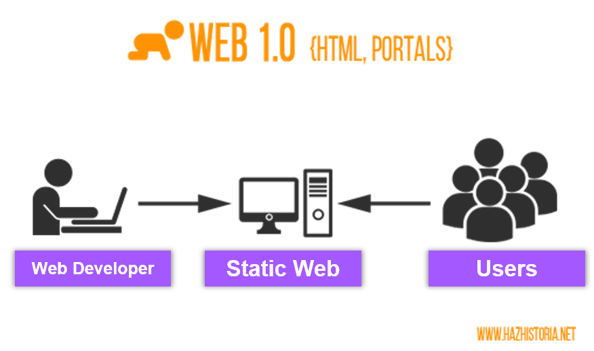
Notes:
HTML (HyperText Markup Language) is the most basic building block of the Web. It describes and defines the content of a webpage.
Portal is a term, generally synonymous with gateway, for a World Wide Web site that is or proposes to be a major starting site for users when they get connected to the Web or that users tend to visit as an anchor site. SEARCH ENGINE

Slide 10
WEB 2.0
The term Web 2.0 was first used around 2004.
Internet technology became more and more interactive.
The internet became more available for everyone.
The users can now interact, contribute, and create their own internet space and content (Explosion of Information & Social Media).
Notes:
It is difficult to identify when this transition began. It just happened.

Slide 11

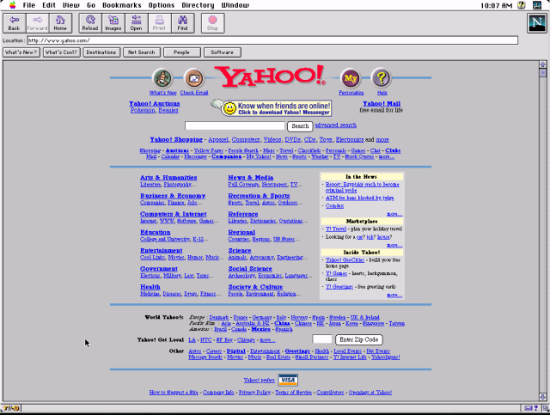

Slide 12
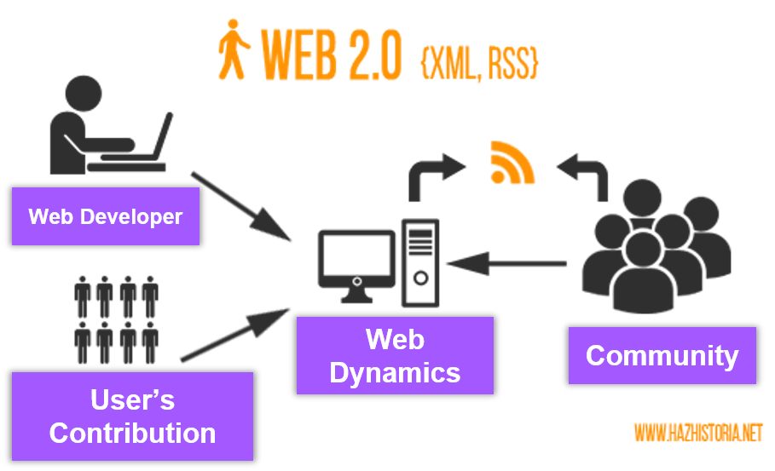
Notes:
XML stands for eXtensible Markup Language. XML was designed to store and transport data. XML was designed to be both human- and machine-readable.
RSS (Rich Site Summary; originally RDF Site Summary; often called Really Simple Syndication) is a type of web feed^{[2]} which allows users to access updates to online content in a standardized, computer-readable format.

Slide 13
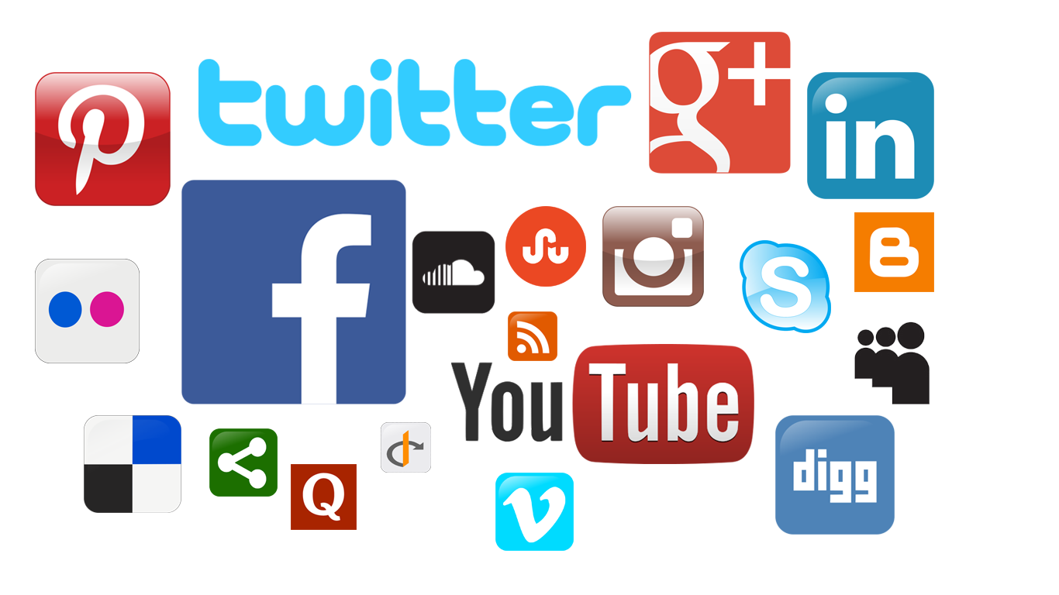

Slide 14
WEB 3.0
It is described by Time Berners-Lee (Father of the WWW) as the read-write-execute web.
It is referred to as the semantic web or data driven web content and response.
The context of the search of the user is processed by a programming language to help the user by presenting options of what the person is interested in.
It will not make Web 2.0 obsolete.
Notes:
It is difficult to identify when this transition began. It just happened.

Slide 15


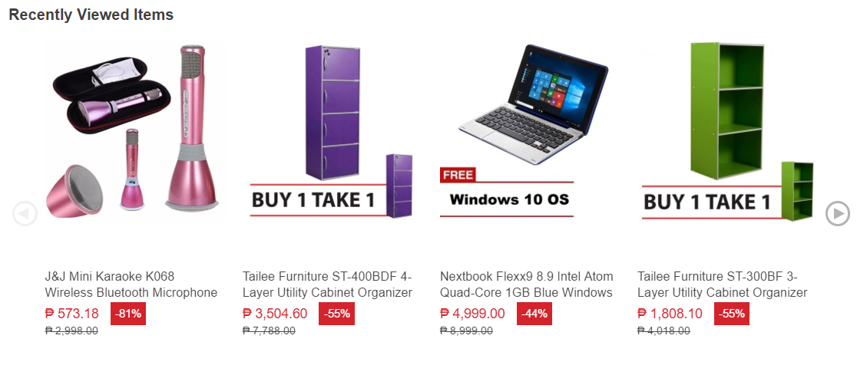
Notes:
Recommendation sonn TripAdvisor.com, Booking.com. Agoda.com, etc.

Slide 16
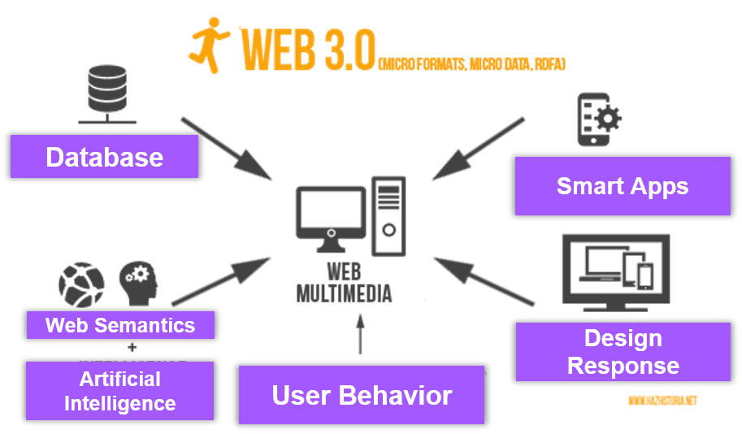
Notes:
Microformats are small patterns of HTML to represent commonly published things like people, events, blog posts, reviews and tags in web pages.
Microdata is a WHATWG HTML specification used to nest metadata within existing content on web pages.
RDFa (or Resource Description Framework in Attributes) is a W3C Recommendation that adds a set of attribute-level extensions to HTML, XHTML and various XML-based document types for embedding rich metadata within Web documents.

Slide 17
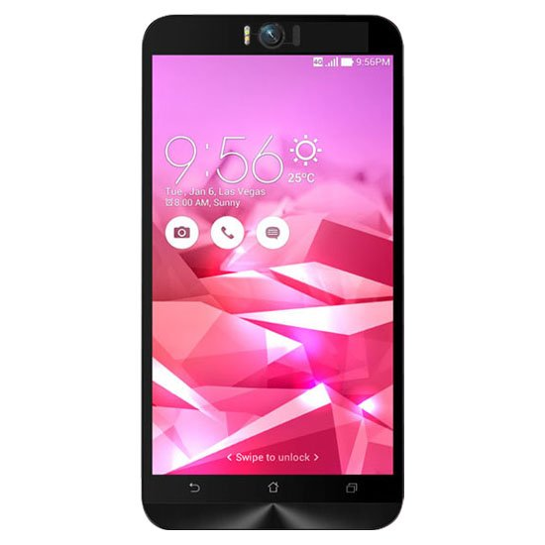
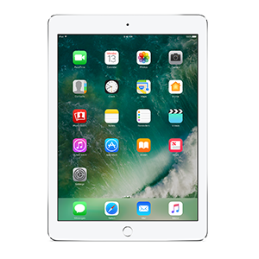

Technology Convergence
It is an evolution of technological developments that merge into a new system bringing together different types of applications and media.
It is the single most important example of technological convergence.

Slide 18
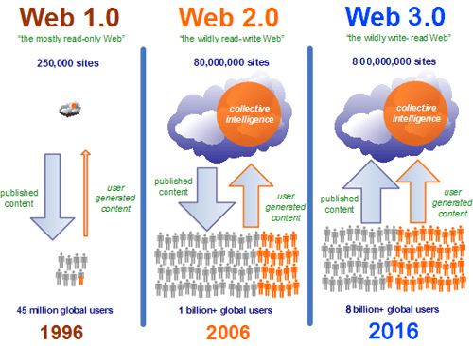

Slide 19




SOCIAL MEDIA
It is a collection of internet-based communication tools and computer assisted channels dedicated to allow users to interact, communicate, and share information in a virtual community and network.

Slide 20

It is a popular free social networking site with more than a billion users around the globe that allows its users to create profiles, upload photos and videos, create and join groups, react to friend’s posts, creative events, send messages, keeping in touch with close friends, and relatives.

Slide 21


With more than 300 Million users in 2016, this social networking site allows users to microblog or broadcast short messages called “tweets.” Registered Tweeter members can also read and follow tweets of other users.

Slide 22


Instagram allows users to edit and upload photos and short videos through a mobile app. Users can add a caption to each of their posts and use hashtags and location-based geotags to index these posts and make them searchable by other users within the app. Each post by a user appears on their followers' Instagram feeds and can also be viewed by the public when tagged using hashtags or geotags. Users also have the option of making their profile private so that only their followers can view their posts.

Slide 23


Snapchat is a mobile app and service for sharing photos, videos, and messages with other people. Once you view a message received via Snapchat, it is automatically deleted. This makes the service ideal for sharing quick updates with friends without accumulating media or messages on your mobile device.

Slide 24
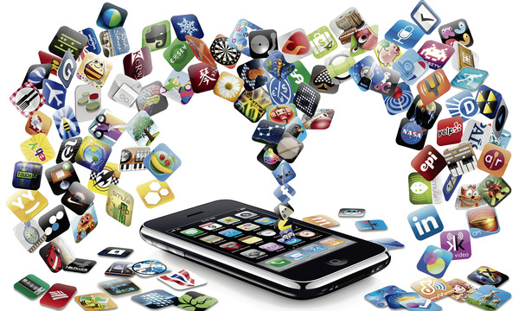
MOBILE MEDIA
A range of handheld devices, from mobile phones, tablets, and e-readers to game consoles, primarily used as personal, interactive, Internet-enabled and user-controlled portable platforms that allow interconnected users to exchange personal and nonpersonal information ( Wei, 2013 ).
Notes:
Smartphones had been dominating the market since they came out. Epitome of the Technological Convergence.

Slide 25
ASSISTIVE MEDIA
It is a nonprofit organization founded in 1996 in Michigan, USA. It was founded by David H. Harvey.
The organization was the first internet-based reading service for persons with visual and reading impairments.
The produce and publish voice-recorded written materials on cassettes, cds, and in the internet.
Notes:
Smartphones had been dominating the market since they came out. Epitome of the Technological Convergence.

